Slide 1
Wave Optics, lecture 5, lesson 4:Polarization of the light
Teacher: Dr. Paul Briard

Slide 2
Introduction
http://1.bp.blogspot.com/-mpdH6XBkFdY/Tjxv3LJq0uI/AAAAAAAAEiA/TL5oFDWWTWk/s1600/3.gif
The stones in the water can be seen using the polarizer

Slide 3
What is the polarization ?
The light is a propagation of an electromagnetic field.
The polarization of the light describes the direction of the electric field vector
Example with an incident plane wave propagating along the along the y-direction :
rection
y
http://www.thephysicsmill.com/blog/wp-content/uploads/Electromagneticwave3D.gif

Slide 4






Direction of a SHM or a transverse oscillation
We have seen the points of the string where a wave is propagating have a SHM if the wave is a sinusoidal wave.
$$y$$
A part of a string
$$O$$
$$x$$
$$x_{0}$$
The oscillation has a certain direction, here the y-axis.
$$y\left(x,t\right)=A\cos{(ωt−kx+φ_{0})}$$
At the position $x=x_{0}$ the point of the string as the SHM:
$$y\left(t\right)=A\cos{(ωt−kx_{0}+φ_{0})}$$
The SHM has a certain direction, here the y-axis.

Slide 5



Direction of a SHM or a transverse oscillation
$$y$$
$$y\left(t\right)=A\cos{(ωt+φ_{0})}$$
$$O+$$
In a spring-mass system, if no friction is considered, there is SHM.
The SHM has also a certain direction, for this example, the y-axis.

Slide 6




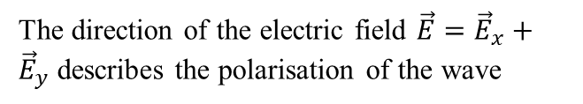






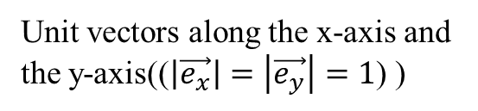

Two components of the polarization
For a z-propagating wave,
$$y$$
$${\vec{e}}_{x}$$
Unit vectors along the x-axis and the y-axis(($\left|\vec{e_{x}}\right|=\left|\vec{e_{y}}\right|=1$) )
$${\vec{e}}_{y}$$
$$E_{x}$$
Component of the electric field
$${\vec{E}}_{y}=E_{y}.{\vec{e}}_{y}$$
$$E_{y}$$
$$\vec{E}$$
The direction of the electric field $\vec{E}={\vec{E}}_{x}+{\vec{E}}_{y}$ describes the polarisation of the wave
$$\vec{k}$$
$${\vec{E}}_{x}=E_{x}.{\vec{e}}_{x}$$
$$x$$
Propagation along z-direction
$$z$$
To understand it, you can imagine a mass having SHM in two perpendicular directions.

Slide 7



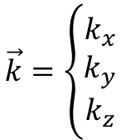
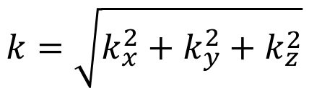

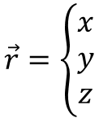




About the direction of propagation
About the wave number in the general case, the wave number at P is:
$$\vec{k}=\left\{\begin{matrix}k_{x} \\ k_{y} \\ k_{z}\end{matrix}\right.$$
$$k=\sqrt{k_{x}^{2}+k_{y}^{2}+k_{z}^{2}}$$
$$y$$
P
$$\vec{r}=\left\{\begin{matrix}x \\ y \\ z\end{matrix}\right.$$
$$0$$
$$z$$
$k_{x},k_{y},k_{z}:$component of the wave vector $\vec{k}$
$$x$$
For a z-propagating wave:
$$k_{x}=k_{y}=0$$
$$k=k_{z}$$
$$\vec{k}.\vec{r}=k_{x}x+k_{y}y+k_{z}z=kz$$
Wave vector
Position vector

Slide 8




Two components of the polarization
For a z-propagating wave, the components of electric field for a sinusoidal wave are:
$$E_{x}=E_{0,x}\cos\left(ωt−kz+φ_{0,x}\right)$$
$$E_{y}=E_{0,y}\cos\left(ωt−kz+φ_{0,y}\right)$$
If $φ_{0,y}=φ_{0,x}$
The components are in phase
Linear polarization
If $φ_{0,y}=φ_{0,x}+π$
The components are in antiphase

Slide 9



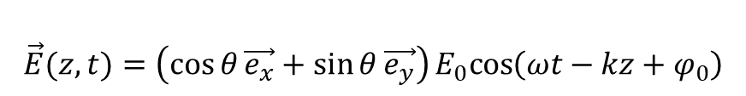





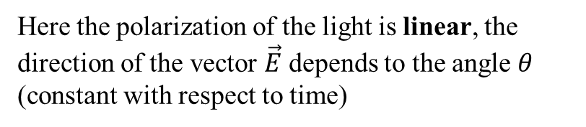
The linear polarization
We consider a z-propagating electric field described as follows:
$$\vec{E}(z,t)=\left(\cos{θ}\vec{e_{x}}+\sin{θ}\vec{e_{y}}\right)E_{0}cos\left(ωt−kz+φ_{0}\right)$$
$$E_{0,x}=E_{0}\cos{θ}$$
$$E_{0,y}=E_{0}\sin{θ}$$
y
E_{y}
$$\vec{E}$$
$$E_{x}=E_{0}\cos{θ}\cos\left(ωt−kz+φ_{0}\right)$$
$$\vec{e_{y}}$$
$$θ$$
x
$$E_{y}=E_{0}\sin{θ}\cos\left(ωt−kz+φ_{0}\right)$$
O
$$\vec{e_{x}}$$
E_{x}
Here the polarization of the light is linear, the direction of the vector $\vec{E}$ depends to the angle $θ$ (constant with respect to time)
Particular case: linear polarization along the x-axis or the y-axis

Slide 10


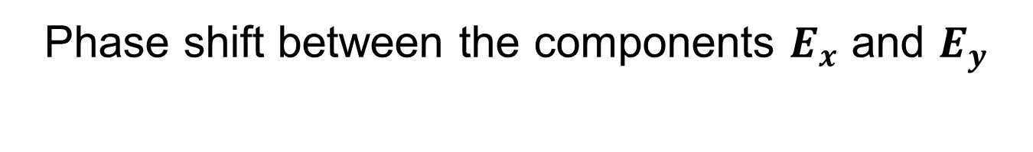



Phase shift between the components $E_{x}$ and $E_{y}$
Now, we consider a plane wave propagating along the z-axis ($k_{x}=k_{y}=0$,$k_{z}=k$). The propagating electric field is described this time by the equation:
$$\vec{E}(z,t)=E_{0,x}\vec{e_{x}}\cos\left(ωt−kz+φ_{0}\right)+E_{0,y}\vec{e_{y}}\cos\left(ωt−kz+φ_{0}+φ\right)$$
$φ$ is the phase shift between the two components along the x-axis and y-axis of the electric field
y
E_{y}
$$\vec{E}$$
$$E_{x}=E_{0,x}\cos\left(ωt−kz+φ_{0}\right)$$
$$\vec{e_{y}}$$
$$E_{y}=E_{0,y}\cos\left(ωt−kz+φ_{0}+φ\right)$$
x
O
$$\vec{e_{x}}$$
E_{x}

Slide 11
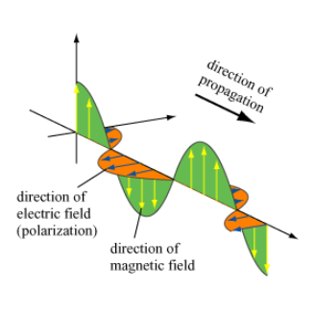


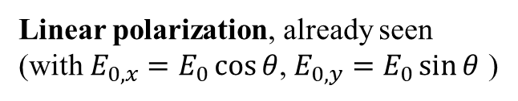


Polarization and phase shift
Now, we consider a plane wave propagating along the z-axis ($k_{x}=k_{y}=0$,$k_{z}=k$). The propagating electric field is described this time by the equation:
$$\vec{E}(z,t)=E_{0,x}\vec{e_{x}}\cos\left(ωt−kz+φ_{0}\right)+E_{0,y}\vec{e_{y}}\cos\left(ωt−kz+φ_{0}+φ\right)$$
Linear polarization, already seen
(with $E_{0,x}=E_{0}\cos{θ}$, $E_{0,y}=E_{0}\sin{θ}$ )
$$φ=0$$
y
E_{y}
$$\vec{E}$$
$$E_{x}=E_{0,x}\cos\left(ωt−kz+φ_{0}\right)$$
$$E_{y}=E_{0,y}\cos\left(ωt−kz+φ_{0}\right)$$
$$\vec{e_{y}}$$
x
O
$$\vec{e_{x}}$$
E_{x}
Example:

Slide 12




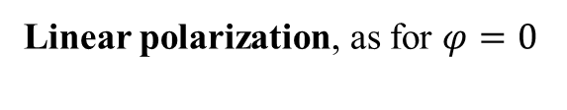




Polarization and phase shift
Now, we consider a plane wave propagating along the z-axis ($k_{x}=k_{y}=0$,$k_{z}=k$). The propagating electric field is described this time by the equation:
$$\vec{E}(z,t)=E_{0,x}\vec{e_{x}}\cos\left(ωt−kz+φ_{0}\right)+E_{0,y}\vec{e_{y}}\cos\left(ωt−kz+φ_{0}+φ\right)$$
If $φ=π:$
$$\vec{E}(z,t)=E_{0,x}\vec{e_{x}}\cos\left(ωt−kz+φ_{0}\right)+E_{0,y}\vec{e_{y}}\cos\left(ωt−kz+φ_{0}+π\right)$$
$$\vec{E}\left(z,t\right)=E_{0,x}\vec{e_{x}}\cos\left(ωt−kz+φ_{0}\right)−E_{0,y}\vec{e_{y}}\cos\left(ωt−kz+φ_{0}\right)$$
$$φ=π$$
Linear polarization, as for $φ=0$
$$y$$
$$\vec{e_{y}}$$
$$E_{x}=E_{0,x}\cos\left(ωt−kz+φ_{0}\right)$$
x
$$E_{y}=−E_{0,y}\cos\left(ωt−kz+φ_{0}\right)$$
O
$$\vec{e_{x}}$$
E_{x}
E_{y}
$$\vec{E}$$

Slide 13
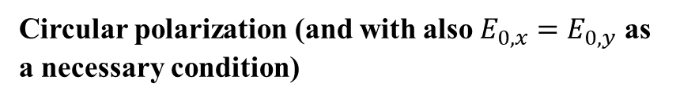
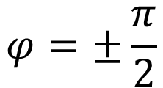
Circular polarization
Now, we consider a plane wave propagating along the z-axis ($k_{x}=k_{y}=0$,$k_{z}=k$). The propagating electric field is described this time by the equation:
$$\vec{E}(z,t)=E_{0,x}\vec{e_{x}}\cos\left(ωt−kz+φ_{0}\right)+E_{0,y}\vec{e_{y}}\cos\left(ωt−kz+φ_{0}+φ\right)$$
$$φ=±\frac{π}{2}$$
Circular polarization (and with also $E_{0,x}=E_{0,y}$ as a necessary condition)
y
E_{y}
$$\vec{E}$$
$$\vec{e_{y}}$$
x
O
$$\vec{e_{x}}$$
E_{x}
http://physicsbuzz.physicscentral.com/2015/12/seeing-photons-in-new-light.html

Slide 14




Elliptic polarization
$$\vec{E}(z,t)=E_{0,x}\vec{e_{x}}\cos\left(kz−ωt+φ_{0}\right)+E_{0,y}\vec{e_{y}}\cos\left(kz−ωt+φ_{0}+φ\right)$$
Other cases than
Elliptic polarization (but take care that linear and circular polarization are particular cases of elliptic polarization)
$$φ=0,π$$
$$φ=±\frac{π}{2},E_{0,x}=E_{0,y}$$
y
E_{y}
$$\vec{E}$$
$$E_{x}=E_{0,x}\cos\left(kz−ωt+φ_{0}\right)$$
$$E_{y}=E_{0,y}\cos\left(kz−ωt+φ_{0}+φ\right)$$
$$\vec{e_{y}}$$
x
O
$$\vec{e_{x}}$$
E_{x}

Slide 15









Summary
E
E
E
E
$$φ=−\frac{π}{2}$$
$$φ=0$$
$$−\frac{π}{2}<φ<0$$
$$\frac{π}{2}<φ<π$$
E
E
E
E
$$0<φ<\frac{π}{2}$$
$$φ=\frac{π}{2}$$
$$π<φ<\frac{3π}{2}$$
$$φ=π$$
Linear polarization
Circular polarization
Other cases of elliptic polarization
With also
$$E_{0,x}=E_{0,y}$$
Important to remember (and understand)

Slide 16
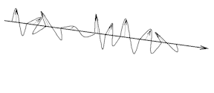





Unpolarized light
The light which come from an incoherent source of light is unpolarized light. The other name for unpolarized light is natural light.
Example: white light from an incandescent bulb or the sun rays
$$y$$
$$\vec{E}$$
$$x$$
The time average of electric fields components along x-axis and y-axis are equal (we consider z-propagating wave)
All the direction of electric field are possible (and random)
$$<E_{x}> =<E_{y}>$$
Light intensity:
$$I_{unpolarized}=I_{x}+I_{y}$$

Slide 17
Polarizer/analyzer
A polarizer or analyzer is a device which apply a linear polarization (circular polarization is possible) to an incident wave (which could have linear, circular, elliptic polarization or could be unpolarized)
Incident light:
偏振片
Polarization axis of the polarizer
线
振
光
The incident light can be unpolarized or polarized (with two components, perpendicular and parallel to the polarization axis of the polarizer )

Slide 18
Polarizer/analyzer
A polarizer or analyzer is a device which apply a linear polarization (circular polarization is possible) to an incident wave (which could have linear, circular, elliptic polarization or could be unpolarized)
https://d1d1c1tnh6i0t6.cloudfront.net/wp-content/uploads/2018/03/Polarization-example-with-linear-polarizers.gif
The incident light can be unpolarized or polarized (with two components, perpendicular and parallel to the polarization axis of the polarizer )

Slide 19


A mistake I have seen often …
This is a polarizer
This is a polaroid
So from now, please to don’t confuse them …

Slide 20




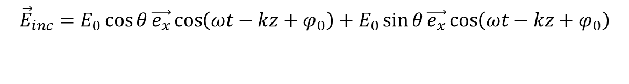




The malus law
The Malus law:
y
$${\vec{E}}_{inc}$$
Electric field incident on the polarizer
$$\vec{e_{y}}$$
$$θ$$
$${\vec{E}}_{out}$$
Transmission axis
Of the polarizer (x-direction in this example)
x
O
$$\vec{e_{x}}$$
E_{x,inc}
$${\vec{E}}_{inc}=E_{0}\cos{θ}\vec{e_{x}}\cos\left(ωt−kz+φ_{0}\right)+E_{0}\sin{θ}\vec{e_{x}}\cos\left(ωt−kz+φ_{0}\right)$$
$${\vec{E}}_{inc}=\text{E}\text{x}\text{,}\text{inc}\vec{e_{x}}+\text{E}\text{y}\text{,}\text{inc}\vec{e_{y}}$$
Incident intensity
After the polarizer:
$${\vec{E}}_{out}=\text{E}\text{x}\text{,}\text{inc}\vec{e_{x}}$$
Light intensity at the output of the polarizer:
$$I_{out}=I_{inc}\cos^{2}θ$$

Slide 21
Polarizer/analyzer
Polarizer and analyzer has the same principle (it is two names to describe the same thing), the purpose is different:
Polarizer is used to apply polarization we wish on a beam. For instance, if we want to illuminate a particle with linear polarization, along the direction wished.
Analyzer is used to examine a component of the light we study, along the transmission axis of the polarizer. For instance, it can be used if we want to study the light scattered by an illuminated particle.
Particle in Optics: droplets, bubbles, soot, nanoparticles …

Slide 22
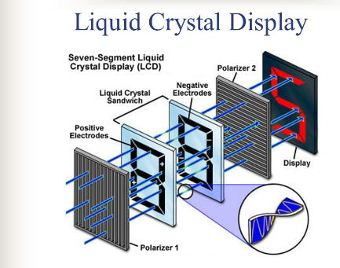
Some applications of polarization
Liquid-Cristal displays (LCD)
http://slideplayer.com/slide/5992315/

Slide 23
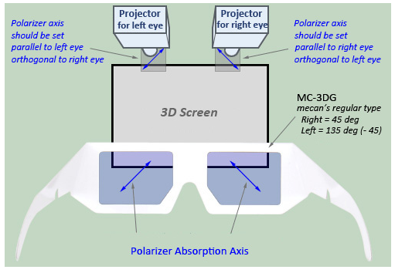
Some applications of polarization
3D displays
http://www.mecanusa.com/polarizer/3D-Glasses/3dglass_instruction.htm

Slide 24
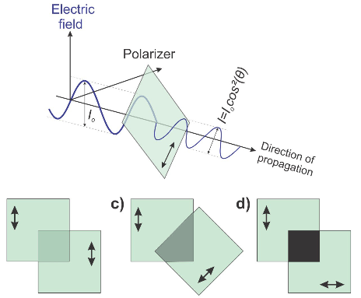
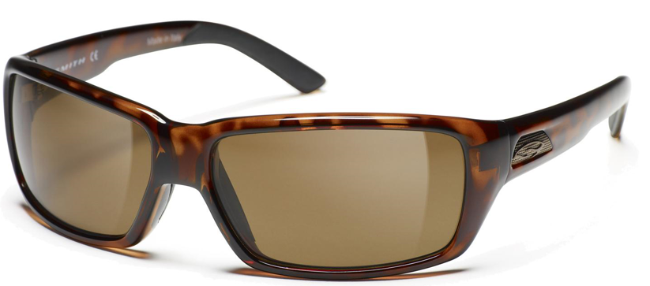
Some applications of polarization
Decrease the light intensity
http://images.evo.com/imgp/1500/33537/217367/smith-backdrop-polarized-sunglasses-totrtoise-polarized-brown.jpg
https://cdn.hackaday.io/images/2095511442624031749.jpg

Slide 25
End of lesson 4, end of the part: Wave Optics. In ppt for students I will send you tonight, I will add a summary of everything important to remember.

Slide 26
Summary of some things important to remember about wave optics

Slide 27
About condition of interferences between two light waves:
They have the same frequency (thus, they have the same wavelength)
Their phase difference at this point is constant with time (to permit to observe the interferences in a interferometric pattern)
The direction of their electric field must be the same

Slide 28













About optical path
Calculation of an optical path
In a medium of uniform refractive index $n$:
Optical path from A to B:
$$δ_{AB}=nl$$
A
B
$$l$$
Converging lens
Focal length
Focal length
$$A$$
$$A$$
$$S$$
$$S$$
$$B$$
$$B$$
$$C$$
$$C$$
$$δ_{AS}=δ_{BS}=δ_{CS}$$
$$δ_{SA}=δ_{SB}=δ_{SC}$$

Slide 29
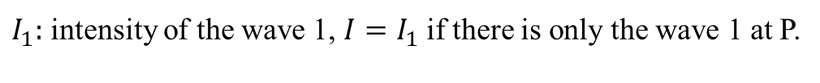

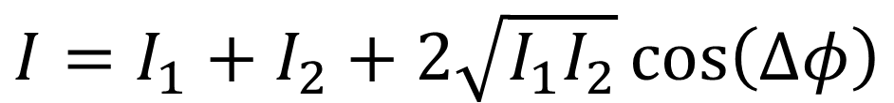

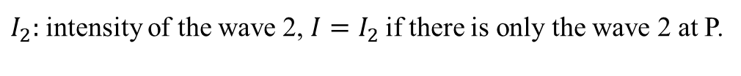
Interferences between two waves
Intensity at a point P of space where two waves interfere:
$$I=I_{1}+I_{2}+2\sqrt{I_{1}I_{2}}\cos\left(∆φ\right)$$
$I_{1}:$ intensity of the wave 1, $I=I_{1}$if there is only the wave 1 at P.
$I_{2}:$ intensity of the wave 2, $I=I_{2}$if there is only the wave 2 at P.
$∆φ$: phase difference at P between both waves
Particular case: $I_{1}=I_{2}=I_{0}$
$$I=2I_{0}\left(1+\cos\left(∆φ\right)\right)$$

Slide 30





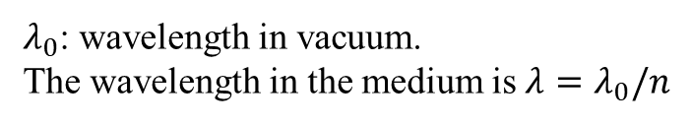

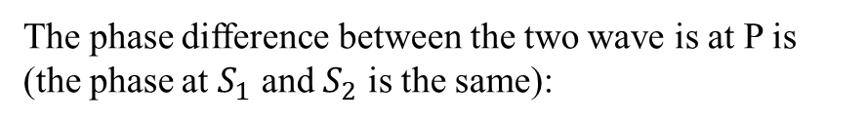
Phase difference between two waves and optical path difference
P
Two waves interfere at P. Their phase difference is:
$$Δφ=\frac{2π}{λ_{0}}δ$$
Wavelength in vacuum
Optical path difference between the waves from a point (or points) the waves have the same phase.
Example of two point sources of light ( where the phase at $S_{1}$ and $S_{2}$ is the same, propagation in a medium of uniform refractive index $n$):
The optical path difference between the two waves is at P is:
$$P$$
$$δ=nS_{2}P−nS_{1}P$$
$$S_{2}$$
The phase difference between the two wave is at P is (the phase at $S_{1}$ and $S_{2}$ is the same):
$$S_{1}$$
$$Δφ=\frac{2π}{λ_{0}}\left(nS_{2}P−nS_{1}P\right)=\frac{2π}{λ}\left(S_{2}P−S_{1}P\right)$$
$λ_{0}$: wavelength in vacuum.
The wavelength in the medium is $λ=λ_{0}/n$

Slide 31


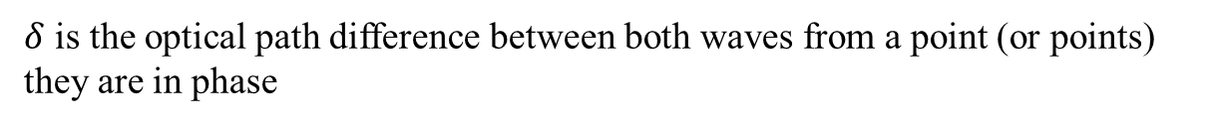





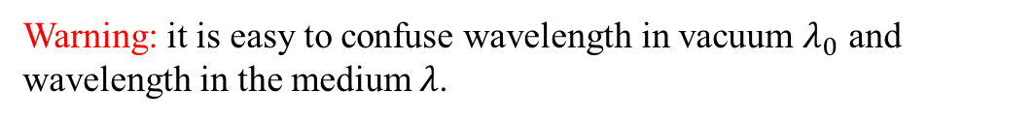
Condition constructive interferences
$$Δφ=…,−2π,0, 2π …$$
$$\cos{Δφ=1}$$
$$Δφ=\frac{2π}{λ_{0}}δ=…,−2π, 0, 2π…$$
$$δ=…,−λ_{0}, 0, λ_{0}….$$
$$δ=mλ_{0}$$
$m=−1,0,1,…$ is an integer (the interference order)
$δ$ is the optical path difference between both waves from a point (or points) they are in phase
Warning: it is easy to confuse wavelength in vacuum $λ_{0}$ and wavelength in the medium $λ$.
!
In air, it doesn’t matter:
$$λ_{0}≈λ$$

Slide 32


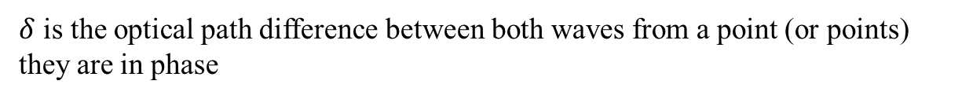


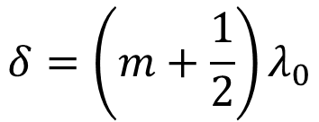
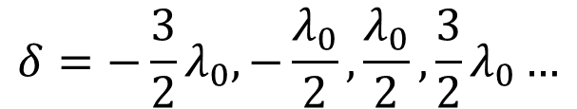
Condition of destructive interferences
$$Δφ=…,−3π,−π, π, 3π…$$
$$\cos{Δφ=−1}$$
$$Δφ=\frac{2π}{λ_{0}}δ=…,−3π,−π, π, 3π…$$
$$δ=−{\frac{3}{2}λ}_{0}, −\frac{λ_{0}}{2},\frac{λ_{0}}{2},{\frac{3}{2}λ}_{0}…$$
$$δ=\left(m+\frac{1}{2}\right)λ_{0}$$
$m=−2,−1,0,1,2…$
$δ$ is the optical path difference between both waves from a point (or points) they are in phase

Slide 33










Half-wave loss
About add an extra- path of $\frac{λ}{2}$ at the reflection of a wave at a interface between two media
If $n_{2}<n_{1}:$
The path difference at P between the incident and the reflected wave is (no half-wave loss):
P
$$d$$
$$l=2d$$
$$n_{1}$$
If $n_{2}>n_{1}:$
$$n_{2}$$
The path difference at P between the incident and the reflected wave is:
$$l=2d+\frac{λ}{2}$$
In air ($n_{air}≈1$ ):
The optical path difference is at P:
$$δ=n_{1}l$$
$$δ≈l$$

Slide 34
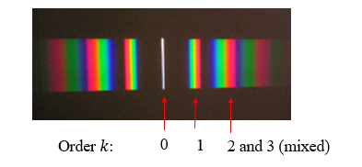

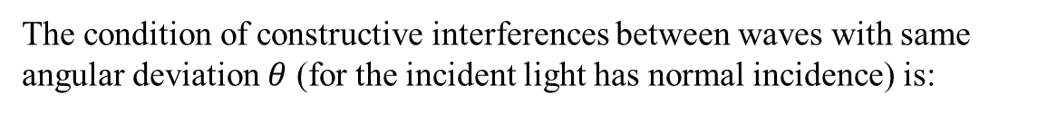


Diffraction grating
The condition of constructive interferences between waves with same angular deviation $θ$ (for the incident light has normal incidence) is:
$$d\sin{θ}=±kλ$$
Grating spacing
$$wavelength$$
$k=0,1,2, …$ is the interference order
You must to remember this result, but you must also to be able to find it by yourself …
The others details we have seen doesn’t matter if you remember this one.

Slide 35



Polarization
If we consider a plane wave propagating in the +z-direction, the electric field has two components $E_{x}$ and $E_{y}$:
$$\vec{E}(z,t)=E_{x}\vec{e_{x}}+E_{y}\vec{e_{y}}$$
$$E_{x}=E_{0,x}\cos\left(ωt−kz+φ_{0}\right)$$
$$E_{y}=E_{0,y}\cos\left(ωt−kz+φ_{0}+φ\right)$$
$φ$ is the phase shift between both components, the kind of the polarization depends to it.
$φ=0,π$: linear polarization (the axis of the polarization don’t change when the wave propagates)
$φ=±\frac{π}{2}$ and $E_{0,x}$=$E_{0,y}$: circular polarization (the electric field describe a circle, its magnitude is constant)
Other cases: Elliptic polarization, i.e. the electric field describe an ellipse.

Slide 36
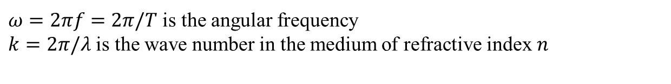

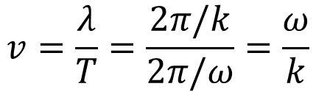
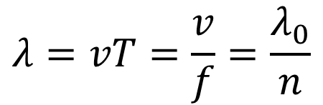
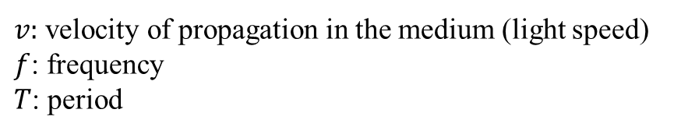


Properties of a light wave
Wavelength $λ$ in a medium of refractive index $n$:
$$λ=vT=\frac{v}{f}=\frac{λ_{0}}{n}$$
$v:$ velocity of propagation in the medium (light speed)
$f$: frequency
$T$: period
Wavelength $λ_{0}$ in vacuum (refractive index of vacuum $n=1$):
$$λ_{0}=cT=\frac{c}{f}$$
Velocity of propagation of a light wave:
$$v=\frac{λ}{T}=\frac{2π/k}{2π/ω}=\frac{ω}{k}$$
$$v=\frac{c}{n}$$
$ω=2πf=2π/T$ is the angular frequency
$k=2π/λ$ is the wave number in the medium of refractive index $n$

Slide 37
End of lesson 4, and end of lessons about wave optics.
Next part is: Introduction to thermodynamics and heat transfers.

